Slide 1

Automated Speaker Verification - A Study in Deep Neural Networks and Transfer Learning
COMP9444 Neural Networks and Deep Learning
Yash Khandelwal, Ahmet Karatas, Damian Basso and Armaan Bhullar
School of Computer Science and Engineering
Faculty of Engineering
The University of New South Wales, Sydney, Australia

Slide 2

The Rise of Language Models
Photo Credit: Image by Free-photos from Pixabay. https://pixabay.com/photos/road-winding-street-bridge-1030789/

Slide 3

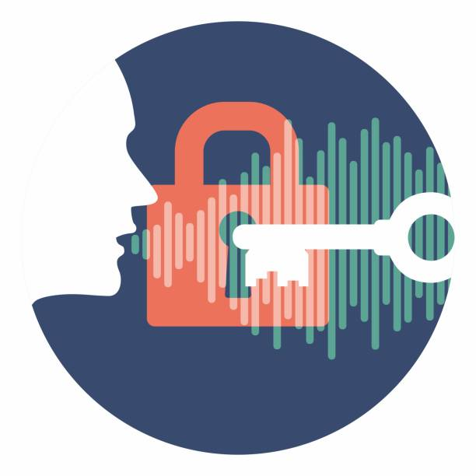

Motivation
Identifying a speaker is key in:
The functioning of virtual assistants
Verifying users for online banking
Voice Biometry
Voice-to-text Transcription
Human voices however differ exorbitantly:
Different Dialects
Wide array of words/ sounds
Background noise
Tone and pace

Slide 4
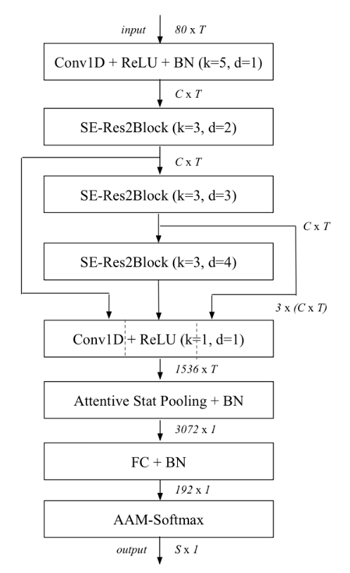
Network Architecture
<Add text here>
Source: Desplanques, B., Thienpondt, J., & Demuynck, K. (2020). ECAPA-TDNN: Emphasized Channel Attention, Propagation and Aggregation in TDNN Based Speaker Verification. Interspeech.

Slide 5
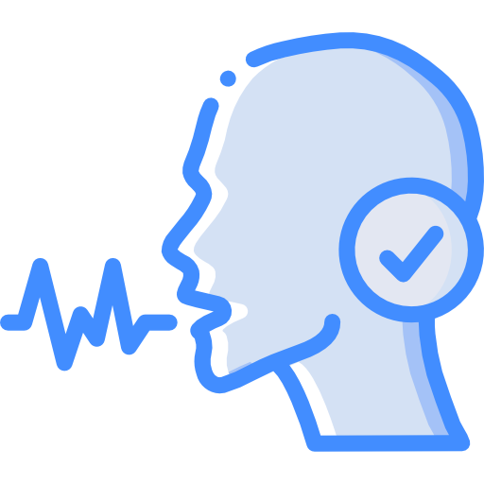
Project Demonstration
Introducing VANET
Our Voice Authentication neural NETwork

Slide 6
Possible Improvements

Slide 7
Summary
…

Slide 8
References
[1] Desplanques, B., Thienpondt, J., & Demuynck, K. (2020). ECAPA-TDNN: Emphasized Channel Attention, Propagation and Aggregation in TDNN Based Speaker Verification. Interspeech.

Slide 9
Questions?

